Slide 1
Wowza ClearCaster
Connect with Confidence on Facebook Live

Slide 2
Introduction
James Jackson
Dir. of Product Mktg
Barry Owen
VP of Engineering
Evan Paul
Dir. of Product Mktg
Wowza ClearCaster

Slide 3
Facebook Live Streaming Benchmark Report
Facebook Live is becoming a dominant live-streaming video platform
Watched by 80 percent of online audience
More popular than streaming-video giant YouTube among weekly live-stream viewers.
Capture audiences who are highly engaged
Viewers on this channel watch live videos three times longer than pre-recorded video
Comment on videos 10x more
Wowza surveyed over 700 video-streaming professionals across a range of industries.
Notes:
To learn more about how organizations are using Facebook Live, Wowza Media Systems surveyed over 700 video-streaming professionals across a range of industries. Our Facebook Live Streaming Benchmark Report 2017 found some compelling results; get the complete report below.

Slide 4
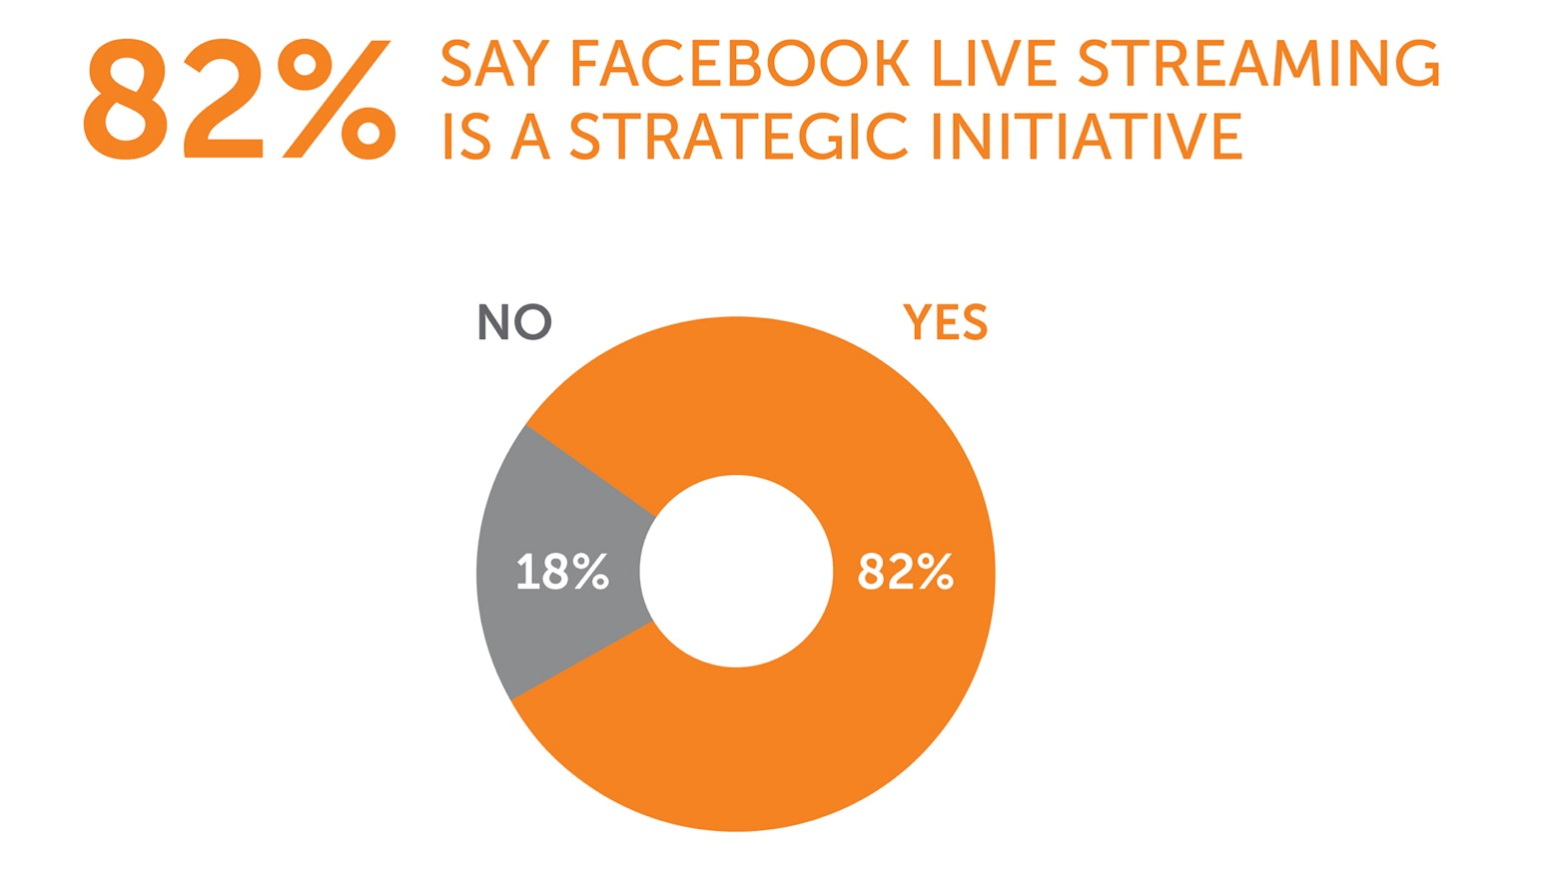
Facebook Live Report

Slide 5
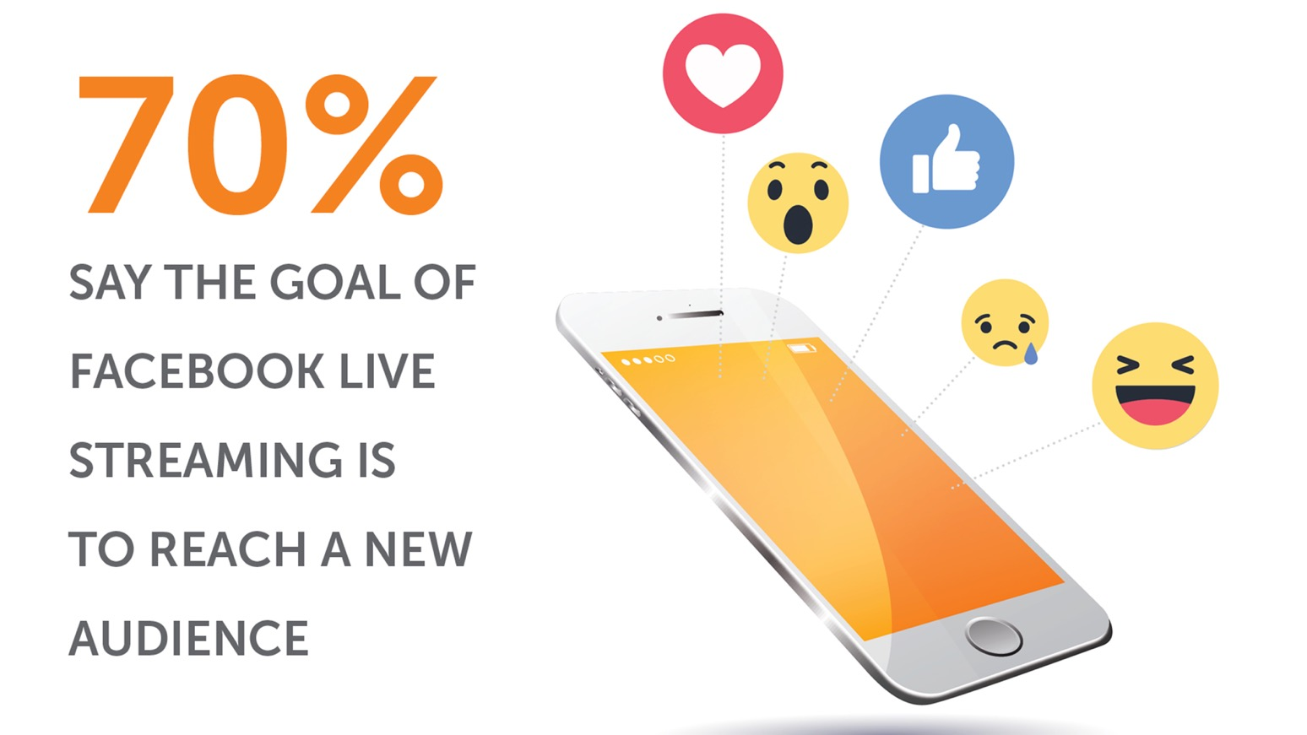
Facebook Live Report

Slide 6
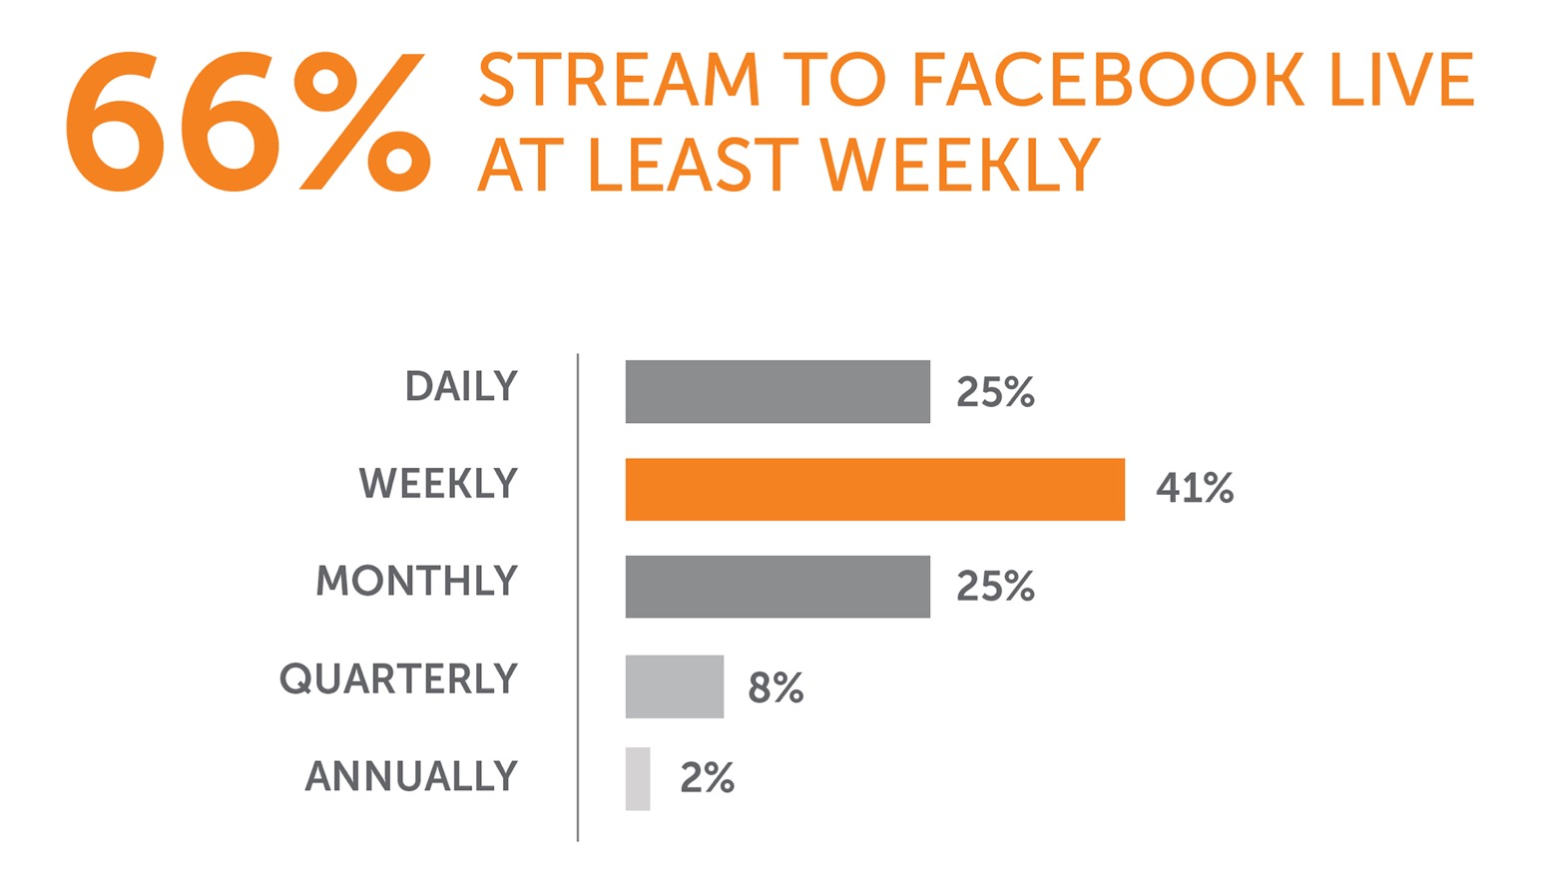
Facebook Live Report

Slide 7
Facebook Live Report

Slide 8
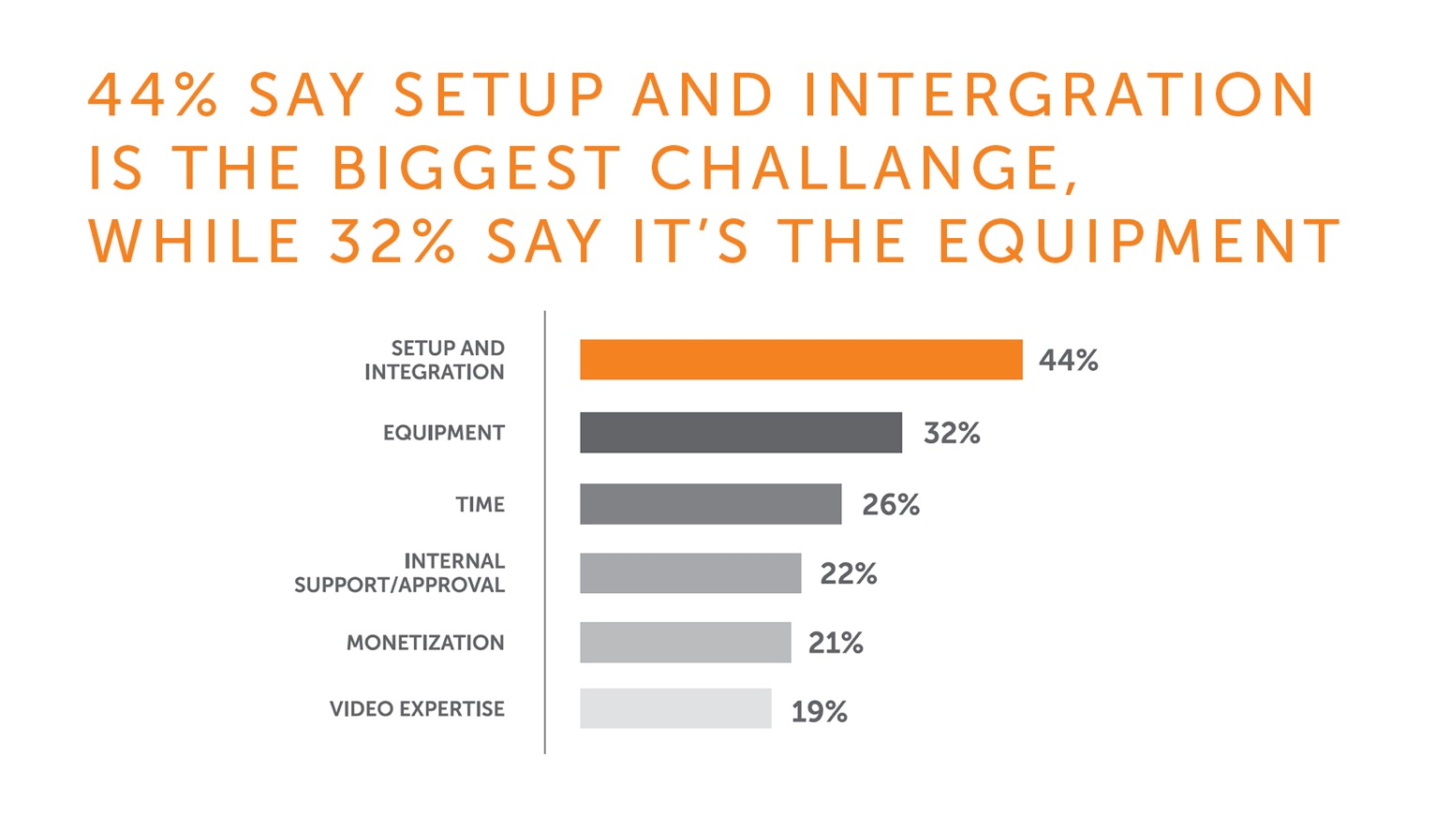
Facebook Live Report

Slide 9
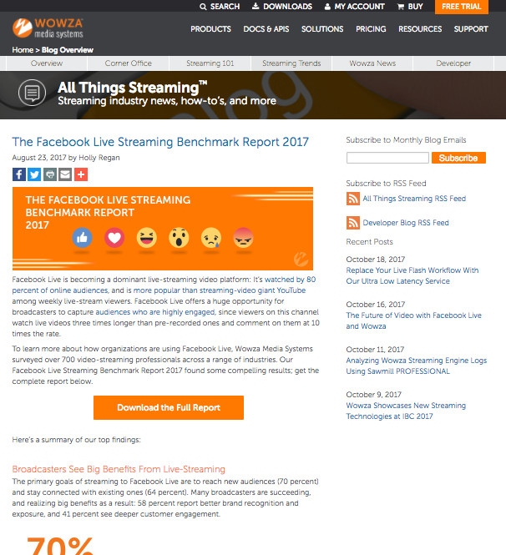
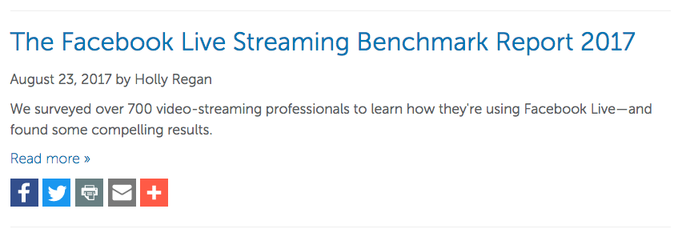
Download the Facebook Live Report Now
www.wowza.com/blog

Slide 10
Unveiling the Wowza ClearCaster
+
=
Notes:
Barry:
Facebook reaches out to Wowza… why?
The history of collaboration with Facebook
Facebook Live API
Connect with Confidence - Purpose-built in collaboration with Facebook, ClearCaster directly connects to Facebook Live’s API, so you’ll always be up to date.
Facebook was familiar with Wowza and our products reached out to us about a year ago to see if we would be interested in a collaborative effort to heklp them solve some problems they were seeing with incoming streams and facebook live, some of the problems were
• Lack of consistent stream configuration (incorrect resolution or bit rate, wrong GOP size, inconsistent frame rate)
• Low incoming stream quality – poor encoding configuration
• Broken connections, bandwidth concerns, no stream health visibility
• Wowza is known to produce consistent quality output from our products – quality transcoding and delivery
• What if we utilized Wowza technology and created a dedicated appliance in collaboration with the FB Live team to address these issues
• How could we enhance the Facebook Live API to work with this appliance to increase broadcast success
• Encoder talks directly to API for proper configuration every time
• Stream health is monitored and adjusted to deliver best quality possible for conditions
• Consistency of incoming stream ensures better playback across the FB live system and more efficient use of the FB Live infrastructre
The end result
• Connect with Confidence - Purpose-built in collaboration with Facebook, ClearCaster directly connects to Facebook Live’s API, so you’ll always deliver the best end to end FB live experience, and be among the first to get new features as they are released (i.e. 1080p, 4k)

Slide 11
Wowza ClearCaster
The WowzaTM ClearCaster™ appliance is a Facebook Live solution purpose-built in collaboration with Facebook to improve the success of your Facebook Live broadcasts.

Slide 12
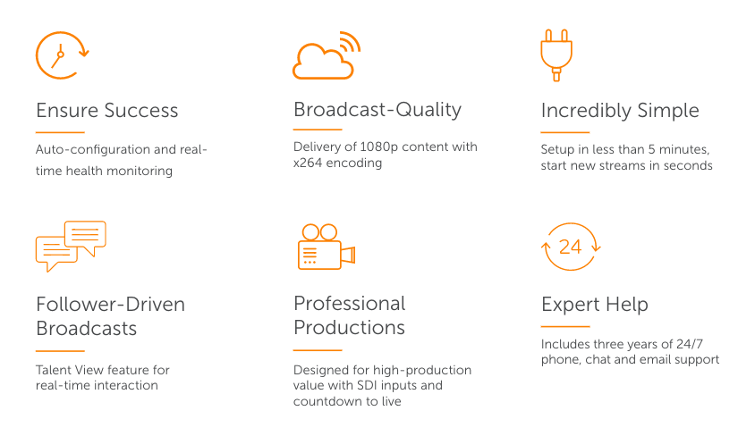
Improving the Success of Facebook Live Broadcasts

Slide 13
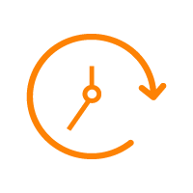
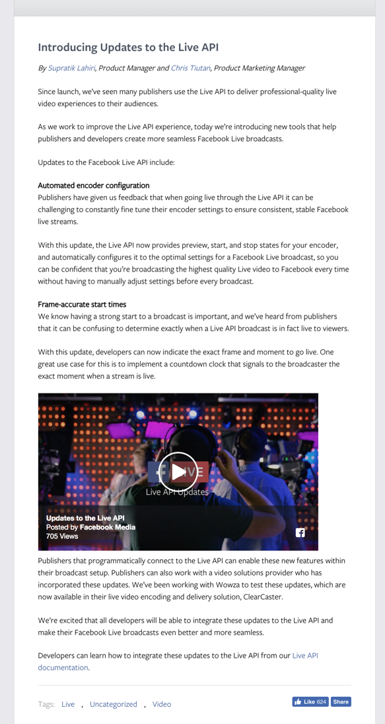
Ensure Success
Only Appliance Deeply Integrated into Facebook Live
Auto-configures optimal encoding settings for your conditions and use.
Real-time stream health monitoring automatically adjusts on the fly to ensure uptime and quality.
Developed to significantly increase the streaming success of Facebook Live broadcasts.
media.fb.com/2017/09/13/introducing-updates-to-the-live-api/

Slide 14
Broadcast-Quality
First way to broadcast 1080p30 on Facebook Live
Up to 4K UHD when supported
Encodes 360° and VR video
Includes x264 for encoding high-quality video, H.264 video streams, and is H.265-ready.

Slide 15
Incredibly Simple
Just plug in, we’ll take it from there
After initial setup, start new live-streams in seconds - the fastest path to Facebook Live success.
Start and stop streams from the Facebook Live user interface – as easy as going live on your mobile phone.
Initial setup is simple and takes less than 5 minutes… let us show you
Plug it in
Turn it on and register it (just once)
Pair it to your Facebook account (one of two ways)
Start a live stream
Create dynamic content with Live Reaction
Stop your stream

Slide 16
Plug ClearCaster In
Network
Video Source
Power Source
To Talent View
Four cords to connect

Slide 17
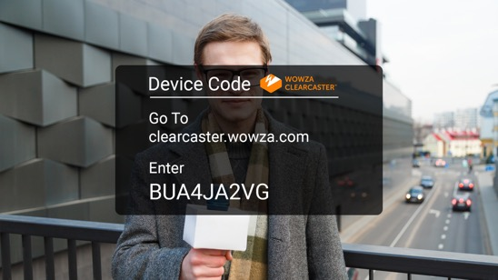
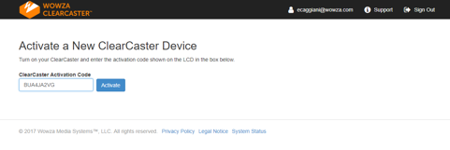
Turn it on and Register it Once
ClearCaster LCD
Talent View
Press the Power Button and let it boot up
From any computer, navigate to clearcaster.wowza.com
Log in using your Wowza credentials (sent to your email)
Register the ClearCaster using the pairing code displayed in the LCD or Talent View screens
Name your ClearCaster and accept the user’ license
Remote Computer

Slide 18
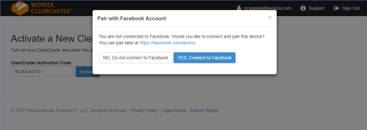
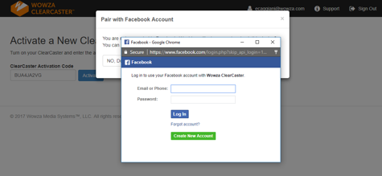
Pair it with Facebook for the First Time
Option 1 for pairing: Pair it with Facebook from the Registration site.
Enter your Facebook credentials.
Confirm that it’s you
Success!
Remote Computer
Remote Computer

Slide 19
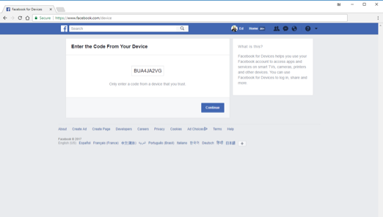
Or, Pair it with any Facebook account
ClearCaster LCD
Talent View
Option 2 for pairing: login to a Facebook account
Once logged-in, navigate to facebook.com/device (as instructed in the LCD and Talent View screens)
Enter the number displayed in the LCD or the Talent View screens and hit enter
Hit the OK button at the prompt.
Success!
NOTE: You only need to pair the ClearCaster with a Facebook account once.
Remote Computer

Slide 20
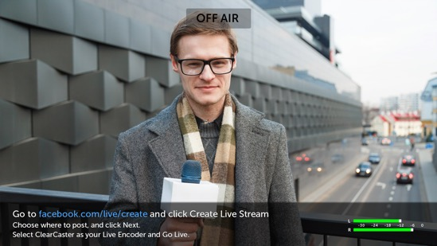
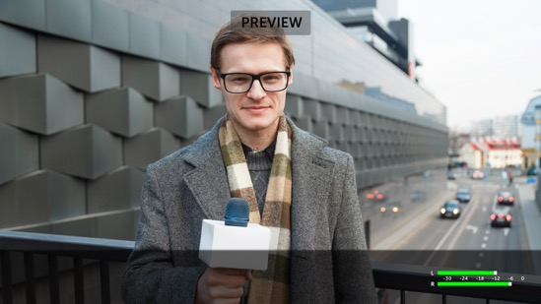
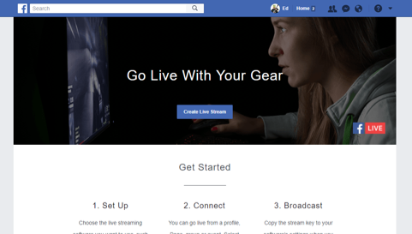
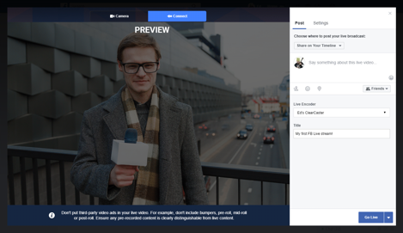
Start a Live Stream
Talent View
Talent View
Talent View: Off Air
From any computer logged into Facebook, click on the ”Go Live” icon or navigate to facebook.com/live/create
Click the blue “Create Live Stream” button
Choose your ClearCaster from the encoder drop down section, give your stream a title and a description and choose your privacy settings
Talent View: Preview
Hit the “Go Live” button
Remote Computer
Remote Computer

Slide 21
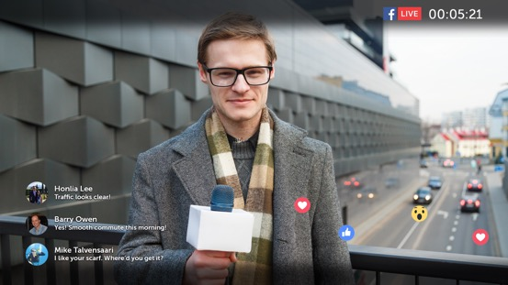
You’re Live
Talent View
Talent View
Frame-accurate Countdown Clock counts you down from three to show when you’re live.
Talent View: On air
Comments and Emojis (Live Reactions) are displayed on the Talent View in real-time

Slide 22
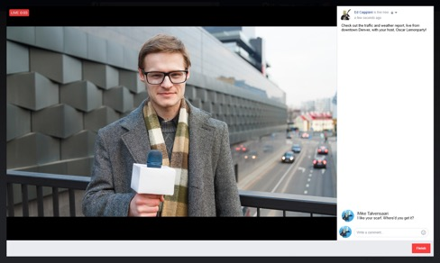
Stop the Broadcast
Remote Computer
When you’re ready to end the broadcast click on the finish button.

Slide 23
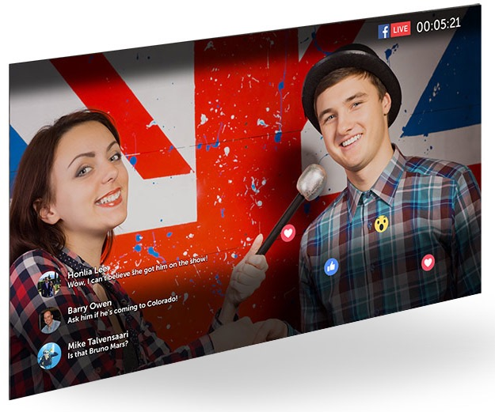
Follower-Driven Broadcasts
Powers the next generation of follower-directed content.
Generate follower engagement and create more loyal fans by leveraging Facebook Live Reactions.
Talent View functionality gives on-camera personalities the ability to see exactly what your followers see.
Plug Into the promise of Facebook Live
Notes:
Interact with your followers with real-time Q&A, hear their opinions and gauge your broadcast with their Live Reactions.
Reach your current followers and easily scale to new, global audiences.
Connect instantly with your followers through Facebook Live notifications, sent every time you go live.
Tell your story and delight your followers with a fun way to brand yourself or your company.

Slide 24
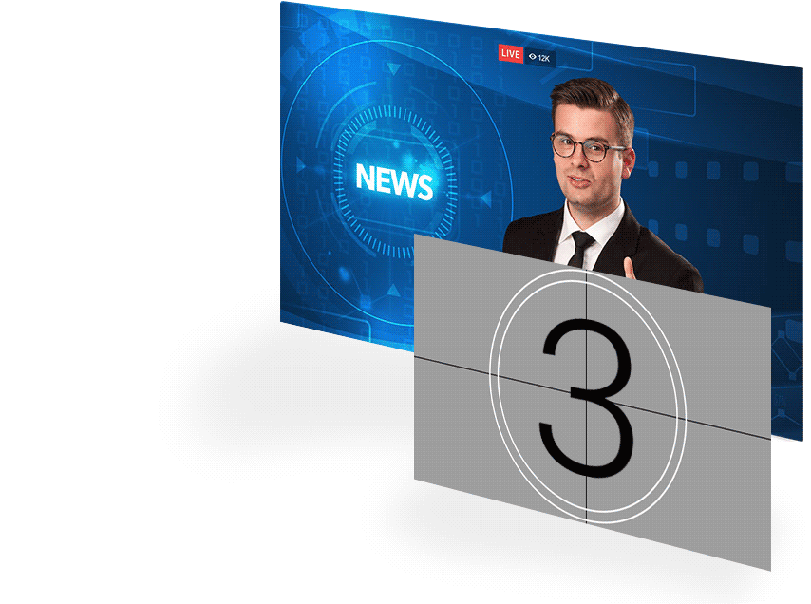
Professional Productions
Eliminate awkward pauses with an frame-accurate countdown clock
SDI input for your professional-grade equipment.
Rack-mounted appliance that easily connects to editing bays and live production studios
Leverage Facebook Live while meeting your high-definition broadcast standards.
Remote access web app for easy management

Slide 25
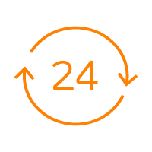
Expert Support
INCLUDED: 3 years of Hardware and Software Maintenance & Support
24/7 phone, chat and email support
Keep ClearCaster plugged in, and we’ll handle the updates

Slide 26
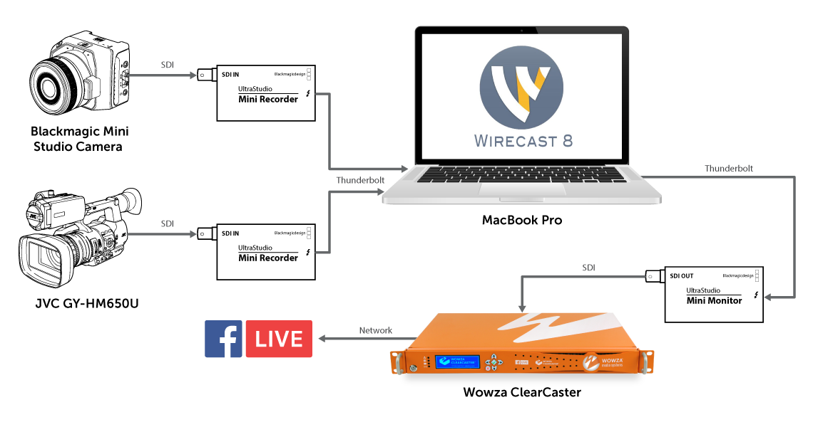
Workflows – Two Camera Setup

Slide 27
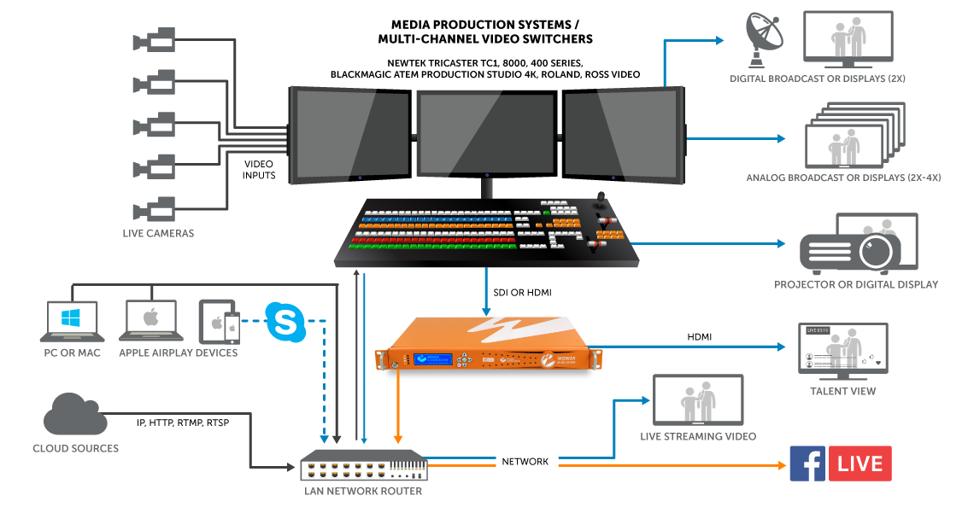
Workflows - Studio

Slide 28
Want to learn more?
www.wowza.com/products/clearcaster
Watch a demonstration
Join us at one of our Roadshows
San Francisco – October 26th
New York – November 9th
Los Angeles – November 16th
Check out our Facebook Live series, Going Live with Wowza
Thursday afternoons
Streaming Media West
And of course, ask questions now!

