Slide 1
Simplifying Scaling and Global Delivery Fall 2017 Product Update
CONFIDENTIAL

Slide 2

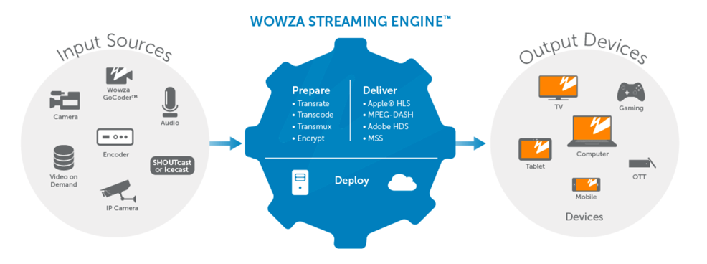

Secure Reliable Transport
Ingest of SRT into Wowza Streaming Engine
Open-source technology for transport to the origin server for:
Wowza Streaming Engine 4.7.2
Overcoming poor network conditions
Replacing expensive bandwidth (Satellite or Dedicated Network)
Increasing the quality of your video without increasing bandwidth
Reliably syndicate your stream from any SRT enabled encoders
Replace proprietary transport protocol platforms
For more information about the open-source initiative visit SRTAlliance.org and check out the Wowza/Haivision SRT blog.
SRT
Accepting SRT enabled streams as of August 21
SRT
Accepting SRT enabled streams as of August 21

Slide 3

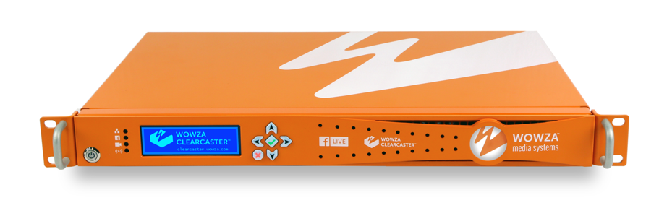
Unveiling the Wowza ClearCaster
Connect with Confidence to Facebook Live
Purpose-built in collaboration with Facebook, ClearCaster directly connects to Facebook Live’s API
Auto-configures optimal encoding settings for your conditions and use.
Real-time stream health monitoring automatically adjusts on the fly to ensure uptime and quality.
Just plug in, and we’ll take it from there.
Generate follower engagement like never before and create more loyal fans by leveraging Talent View functionality giving on-camera personalities the ability to see Facebook Live Reactions.
Frame-accurate Countdown Clock
Schedule a free demo at: info.wowza.com/clearcaster-free-demo

Slide 4



Ultra Low Latency API Preview
Ultra-Low Latency
Large Scale
Managed Service
High Availability
<2-Sec. end to end
RTMP Replacement
No server provisioning
Thousands of simultaneous users
Across regions
Distributed ingest and delivery
Built, monitored and managed by Wowza
PAYG
Consistent high-quality delivery
High quality
Auto scaling
Always on
Built on MS Azure
Contact Sales or visit wowza.com/products/cloud-preview to request access to the ultra low latency preview.

Slide 5
Q &A

